Slide 1
Intermediate Algebra
Clark/Anfinson

Slide 2
Chapter 7
Rational Functions

Slide 3
Chapter7 - section1
Rational models

Slide 4
Direct variation
“varies directly” means the ratio between the variables is constant – ie slope is constant and you have a linear relation going through the origin
Also sometimes said as “directly proportional”
or simply “in proportion”
Ex: Area varies directly to the length for all rectangles. Write an equation for the area of a rectangle that is 3 inches wide as a function of length.
Ex: the cost of an item is 50¢ each. Write a function for the cost of purchasing several of the items.

Slide 5
Inverse variation
Means that the product of the variables is constant. This is a reciprocal relation.
f(x)= k/x
Functions of this type are referred to as rational functions
Ex: the pie will be divided equally amongst all the participants. Then the amount of pie each gets is a function of the number of participants
a(p) = 1/p

Slide 6
Restricted domain and range
Stated restrictions: if the domain is restricted then the range is restricted
Ex: A school has 1500 students. They are put into classes each period. There are 70 teachers but they do not all teach each period. At least 30 teach each period. The number of students in each class is a function of the number of teachers teaching that period.
Write the function. State its domain and determine its range

Slide 7
Restricted domains - implied
The domain of a rational function is restricted by its denominator.
Any value that makes the denominator zero is excluded from the domain
These values cause a “skip” in the graph and generally cause the graph to shoot off to infinity or to negative infinity- The vertical line at these points is called an asymptote

Slide 8

Examples
$f\left(x\right)=\frac{5−2x}{x}$
$g\left(x\right)= \frac{2x}{x−5}$
$k\left(x\right)=\frac{x + 8}{(x −9)(x+2)}$
$j\left(x\right)=\frac{x^{2}−9x}{x^{2}+9x+18}$

Slide 9
Asymptotes in graphs

Slide 10
Another example

Slide 11
Chapter 7 – Section 2
Division and simplifying rational expressions

Slide 12
Rational – can divide
Rational expressions imply division
When the division occurs “exactly” the numbers involved are called factors
When the division does not occur “exactly” the result is a mixture of “whole” and “fractional” pieces - a Mixed number

Slide 13
Dividing by a monomial
This is done by distribution
Ex: $\frac{15x^{2}−5x+6}{3x}$

Slide 14
Dividing by a binomial
This is like long division on numbers done by hand . It is also like “unfoiling”.
The shorthand version is called synthetic division
ONE purpose of division is to factor higher order polynomials
Example: divide – complete the factorization
a. $\frac{x^{3}−2x^{2}−19x^{2}+20}{x −5}$
b. $\frac{2x^{3}+9x^{2}+4x−15}{2x+5}$

Slide 15
Fractions
When the denominator is not a factor of the numerator you have a rational expression: ie a fraction
A fraction is considered simplfied when it does not share any factors with the numerator
Ex: $\frac{2}{3}$is simplified $\frac{4}{6} \frac{20}{30} \frac{−14}{−21}$are the same number but not simplifies

Slide 16
Simplifying rational expression
Determine FACTORS of the numerator and of the denominator and cancel any that match
Examples:
$\frac{2x^{2}y}{14xy^{5}}$ $\frac{\left(x−2\right)(x+5)(x+4)}{(x+4)(x+10)(x −2)}$
$\frac{x^{2}−4}{x^{2}−5x+6}$ $\frac{10−5x}{x^{2}−7x −18}$ $\frac{x^{3}−27}{x^{2}+2x−15}$

Slide 17
Chapter 7 – section 3
Multiplying and dividing rational expressions

Slide 18
Multiplying/dividing
Since a fraction IS a division problem – multiplying or dividing 2 rational expressions involves regrouping the multiplication and division – i.e. Group the numerators, group the denominators – simplify the resulting fraction(factor everything)
CANCEL before you “do” any multiplying
factored form of the polynomial is acceptable in the answer
Division – implies reciprocals - keep change flip

Slide 19
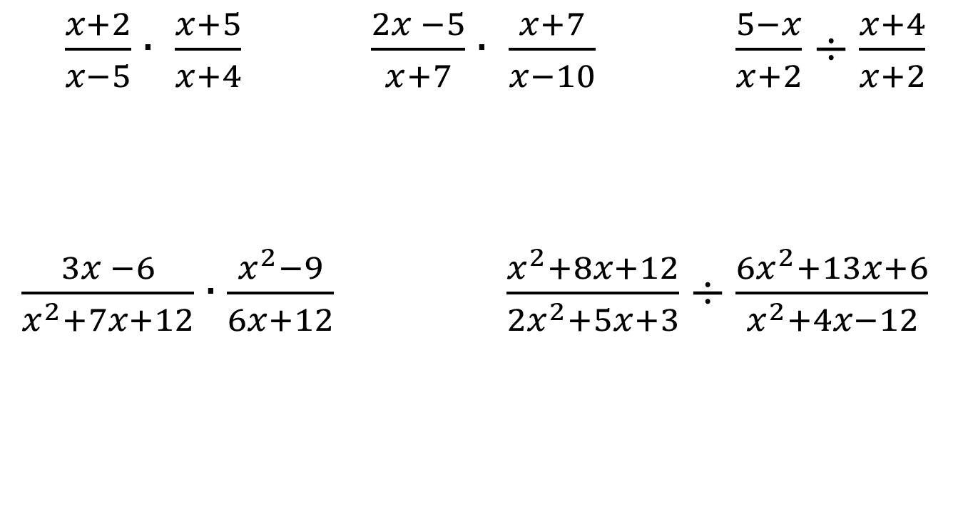
Examples: simplify
$\frac{x+2}{x−5}∙ \frac{x+5}{x+4}$ $\frac{2x −5}{x+7}∙ \frac{x+7}{x−10}$ $\frac{5−x}{x+2}÷\frac{x+4}{x+2}$
$\frac{3x −6}{x^{2}+7x+12}∙\frac{x^{2}−9}{6x+12}$ $\frac{x^{2}+8x+12}{{2x}^{2}+5x+3}÷\frac{{6x}^{2}+13x+6}{x^{2}+4x−12}$

Slide 20
Chapter 7 – Section 4
Addition of rational expressions

Slide 21
Addition requires “like terms”
In fractions like terms mean “common denominators”
Fractions can be altered in appearance ONLY by multiplying so common denominators are based on FACTORS

Slide 22
Step 1:Find a common denominator
Case 1 – already same
$\frac{x+5}{x −3}+\frac{2x −9}{x −3}$
Case 2 - share no factors
$\frac{5x}{x}−\frac{x+4}{2}$ $\frac{x−2}{x+4}+\frac{3x}{x+2}$ $\frac{5x}{2x+3}−\frac{3x−4}{3x}$
Case 3 - share some factors
$\frac{x^{2}}{3y}−\frac{2}{6xy}$ $\frac{x+3}{5x+10}+\frac{3x}{x+2}$ $\frac{4x}{x^{2}−9}+\frac{x+7}{x^{2}+7x+12}$

Slide 23
Step 2: change numerators – simplify completely
Case 1 – already same
$\frac{x+5}{x −3}+\frac{2x −9}{x −3}$
Case 2 - share no factors
$\frac{5x}{x}−\frac{x+4}{2}$ $\frac{x−2}{x+4}+\frac{3x}{x+2}$ $\frac{5x}{2x+3}−\frac{3x−4}{3x}$
Case 3 - share some factors
$\frac{x^{2}}{3y}−\frac{2}{6xy}$ $\frac{x+3}{5x+10}+\frac{3x}{x+2}$ $\frac{4x}{x^{2}−9}+\frac{x+7}{x^{2}+7x+12}$

Slide 24
Step 3: combine like terms in numerators
Case 1 – already same
$\frac{x+5}{x −3}+\frac{2x −9}{x −3}$
Case 2 - share no factors
$\frac{5x}{x}−\frac{x+4}{2}$ $\frac{x−2}{x+4}+\frac{3x}{x+2}$ $\frac{5x}{2x+3}−\frac{3x−4}{3x}$
Case 3 - share some factors
$\frac{x^{2}}{3y}−\frac{2}{6xy}$ $\frac{x+3}{5x+10}+\frac{3x}{x+2}$ $\frac{4x}{x^{2}−9}+\frac{x+7}{x^{2}+7x+12}$

Slide 25
Step 4: factor numerator IF possible to cancel IF possible

Slide 26
More examples
$\frac{\frac{3}{2x}}{\frac{6}{7x^{2}}}$ $\frac{x−\frac{1}{x}}{\frac{x−3}{2}+2}$

Slide 27
Chapter 7 – section 5
Solving rational equations

Slide 28
Solving
Find what x =
If x is in the denominator you cannot find what x =
Clear denominator

Slide 29
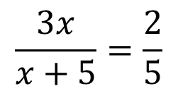
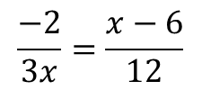
Examples: solve
$$\frac{3x}{x+5}=\frac{2}{5}$$
$$\frac{−2}{3x}=\frac{x−6}{12}$$
$$\frac{x+3}{x−2}=\frac{x+12}{3x −10}$$

Slide 30
Examples

